Slide 1
CHILE-Harvard 2014 Group 3
Régis Cartier, Lehman Garrison, Anita Mehrotra, Francisco Richter

Slide 2
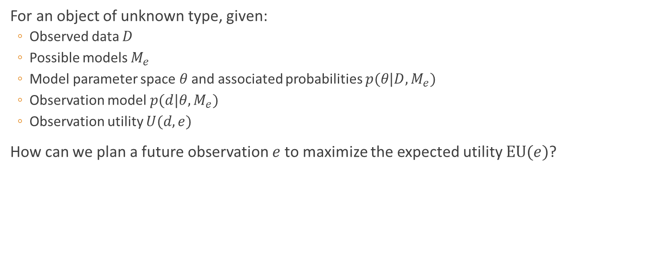
Designing Observations to Maximize Utility
For an object of unknown type, given:
Observed data $D$
Possible models $M_{e}$
Model parameter space$θ$ and associated probabilities $p(θ|D,M_{e})$
Observation model $p(d|θ,M_{e})$
Observation utility $U(d,e)$
How can we plan a future observation $e$ to maximize the expected utility $EU(e)$?

Slide 3
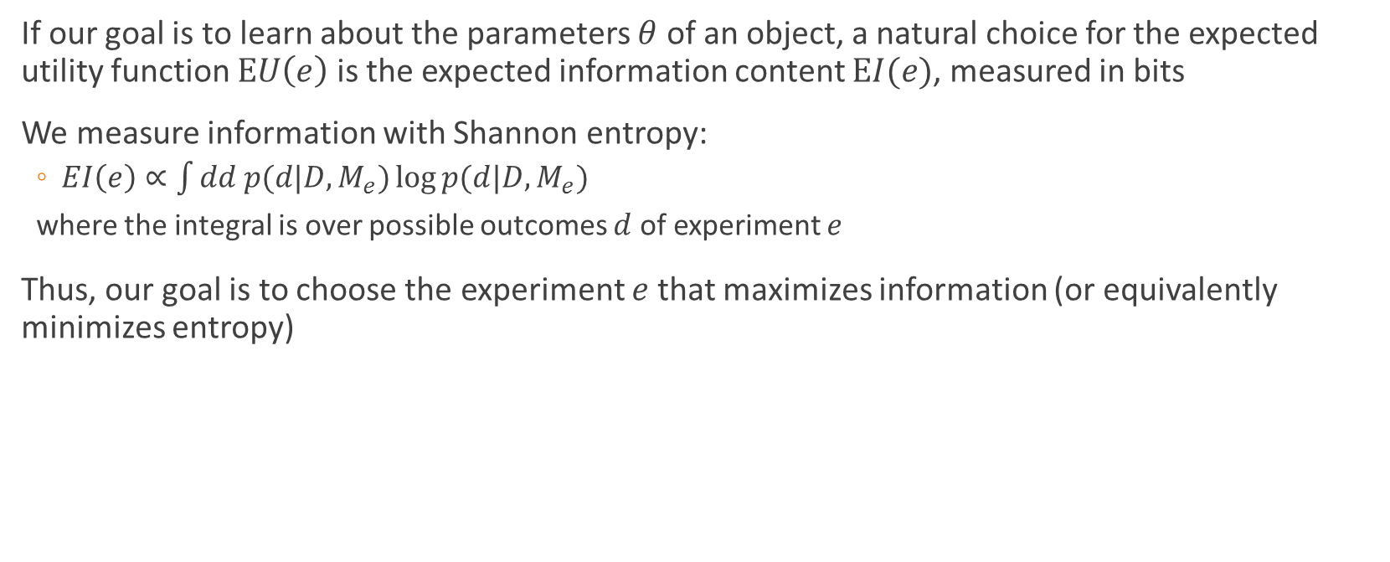
Designing Observations to Maximize Information
If our goal is to learn about the parameters $θ$ of an object, a natural choice for the expected utility function $EU\left(e\right)$ is the expected information content $EI(e)$, measured in bits
We measure information with Shannon entropy:
$EI\left(e\right)∝\int{dd p(d|D,M_{e})}\log{p(d|D,M_{e})}$
where the integral is over possible outcomes $d$ of experiment $e$
Thus, our goal is to choose the experiment $e$ that maximizes information (or equivalently minimizes entropy)

Slide 4
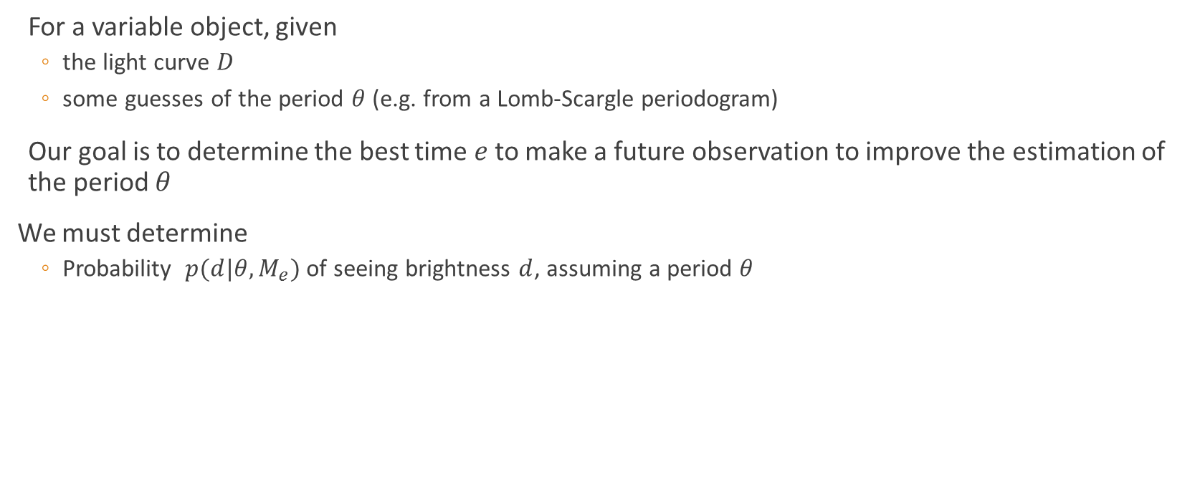
Application 1: Planning observations to improve period measurements of variable stars
For a variable object, given
the light curve $D$
some guesses of the period $θ$ (e.g. from a Lomb-Scargle periodogram)
Our goal is to determine the best time $e$ to make a future observation to improve the estimation of the period $θ$
We must determine
Probability $p(d|θ,M_{e})$ of seeing brightness $d$, assuming a period $θ$

Slide 5
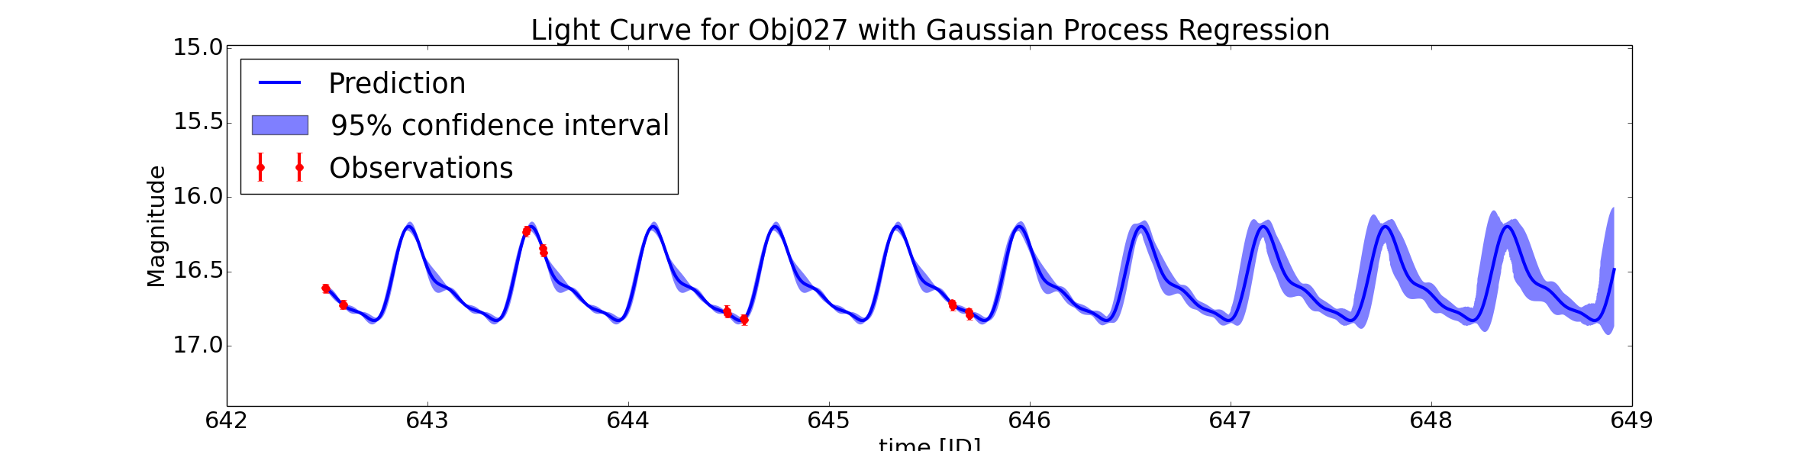

Application 1: Planning observations to improve period measurements of variable stars
How to generate $p(d|θ,M_{e})$; that is, how to predict the behavior of a periodic variable in the future?
Use non-parametric Gaussian process regression!
Given a guess of the period, determines the shape of the light curve
Uses a periodic correlation kernel $K_{T,σ}(x_{i},x_{j})=$

Slide 6

Application 1: Planning observations to improve period measurements of variable stars
Armed with our predictive model $p(d|θ,M_{e})$, we compute the expected gain in information $EI(e)$ for an observation at time $e$
[graph here of information gain, like fig. 2(d) in Loredo]

Slide 7
Application 2: Increasing classification certainty
For an object with uncertain classification (e.g. supernova, quasar, variable star)

